Slide 1
CASE STUDY BASED ON MERCEDES - BENZ
Based on the Indian Scenario
Made by-
Suraj Satpathy
Muhammed Asu
Shivam Sharma
Chitra Pandey

Slide 2
01
Objectives of the
Study
Macroeconomic and Microeconomic Analysis
02
Business Strategy
03
SWOT Analysis
04
Recommendations for Future Plans

Slide 3
Introduction
About Company
Important Figures and Facts

Slide 4
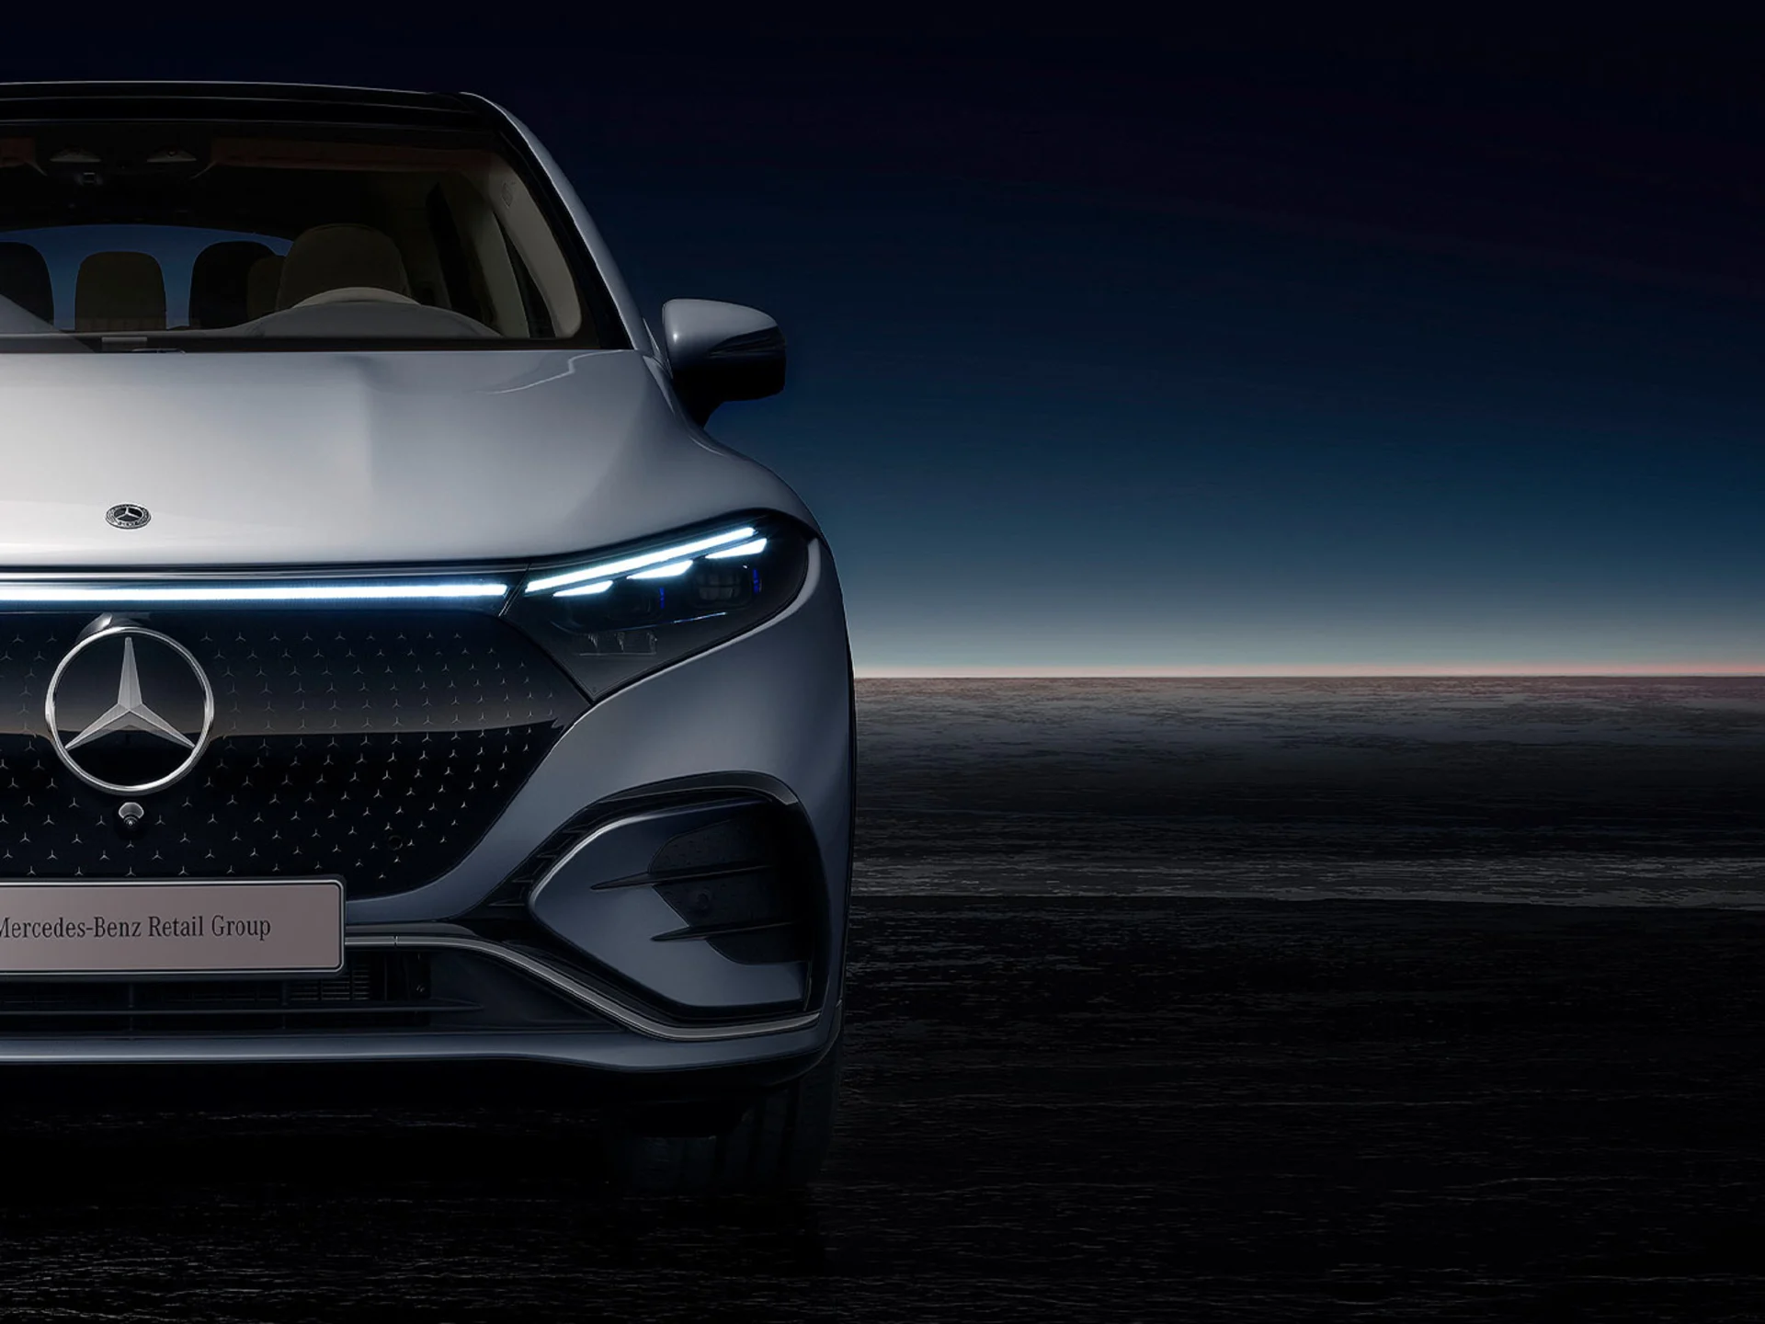
About Mercedes-Benz
A subsidiary of the German Mercedes-Benz Group, Mercedes-Benz India Pvt. Ltd. was established in 1994 and has its headquarters in Pune, Maharashtra, India.
Mercedes-Benz has a 40% market share in India, which is the highest of all luxury automakers. Only Mercedes Benz has an R&D facility in India, which is known as (MBRDI). This center's mission is to serve the parent company in Germany's IT infrastructure and product development. However, this R&D facility is not focused on creating personalized automobiles for Indian consumers.
In contrast to the higher- end models, the C and S class of Mercedes automobiles incorporate more locally produced design and parts. These designs related decisions are, however, heavily centralized to the German headquarters in Stuttgart, even for the localization of designs.
Mercedes - Benz
The Best or Nothing

Slide 5
Important Figures and Facts
The Made-in-India EQS EV by the luxury automaker has more than 300 confirmed reservations, while the LWB E-Class is the most popular and best-selling luxury sedan in the nation. Apart from Germany, India is the only country in the world to produce S-Class Maybach and EQS. GLE and GLS premium SUVs made up 30% of the sales volume for Mercedes-Benz India in the third quarter of FY23.
11,469
28%
20,000
42.5%
Cars
Sold*
Yearly Sales
Growth*
Annual Production
Capacity
Market
Share**
* For Jan – September, 2022
** Based on 2021 statistics

Slide 6
Macroeconomic and Microeconomic Analysis
PESTLE Framework of Automobile Industry
Porter’s Diamond Framework of Automobile Industry

Slide 7
Porter’s Diamond Framework
Supplier’s Power
Small suppliers
Easy to switch suppliers
No threat of forward integration from suppliers.
Buyer’s Power
Barriers to Entry
High price sensitivity
Changing customer trends
Easy to switch between brands.
High Degree of Competition
High Investment Cost
Advantage of Economies of Scale
Segmented Market
Differentiated Oligopolistic Market
Price Rigidity
Market Rivalry
High Competition
High Barriers to Entry
Customer Loyalty is High
Fewer Firms occupy major market share
Competition in terms of Design, Quality, Technology, and Customer Safety
Mostly non-price competition
High investment in research and innovation
Availability of Substitutes
Public mode of transport are the best substitutes
However, that doesn’t impose a great threat
Overshadowed by behavioral and psychological patterns
Compliments
Oil Prices impacts the behavioral pattern in the market
High degree of competition in the industry implying tough entry and a need for high investments.

Slide 8
Political Factors
1. Political Factors
Low Emission Policy
Higher import duties on import of foreign cars
Make in India and Made in India policies
Emphasis on road safety measures
Pestel Analysis
Economic Factors
2. Economic Factors
Good economic position amidst tough times all across the world
5th largest economy by nominal GDP and 3rd largest by PPP
Indian automotive industry became 4th largest in the world in 2021
Contributes 8% to total export and accounts for 2.3% of India's GDP
Sociological Factors
3. Sociological Factors
Cars treated as a status symbol
Good proportion of joint families in India

Slide 9
Technological
Factors
4. Technological Factors
Subjected to continuous advancements and innovations.
Safety Related technological advancements
Automation related technological advancements
Environmental friendly technological advancements
Environmental
Factors
5. Environmental Factors
Low Carbon Emission goals
Low fuel consumption level
Pestel Analysis
Regulatory Factors
6. Legal and Regulatory Factors
Environmental Regulatory laws
Tax Laws
Infrastructure
7. Infrastructure
Good and increased roads network
Good network of filling stations

Slide 10
Business Strategy
Mode of Entry
Product/ Service Analysis
Revenue and Distribution Strategy
Marketing Strategy
Customer Journey Map
Market Size Estimation
Competitor Analysis

Slide 11
Case of Entry to Indian Market
Name of Company | Mercedes Benz India Limited
Timing of Entry | October 1995
Market segment | Super Luxury Segment
Entry Mode | Joint Venture
Partner | Tata Engineering and Locomotive Company Ltd.
Capital Structure | Benz - 51% Telco - 49%
Total Investment | $116.67 million
Distribution from | Pune, Maharashtra
Production Target | That time: 2.5% Target: 70% by 2000 and 80% in 10 years
Indigenization Level | That time: 2.5% Target: 70% by 2000 and 80% in 10 years
New Automobile Policy of 1993 attracted many automobile brands to India
Wider variety of choices available for customers
Sales of around 300,000 passenger cars in 1996-97, sales are expected to rise to 850,000 to 1.7 million vehicles by 2000
Segmentation in market was based on price
Mostly these brands were importing completely knocked down (CKD) kits and assemble them in India – but was subjected to high import duties
Incentive to increase the indigenization Level

Slide 12
Product Analysis
Products can be analyzed based on Price, Features, Performance, Quality and Design.
Services offered can be analyzed by customer experience, warranty, customization and safety features.
1. Price
High priced
Luxury brand car
Niche market
1. Customer Experience
Customer Loyalty and Retention
Speedy responsiveness on part of dealers
2. Features
ADAS
Active Lane Keeping Assist
Active Blind Spot Monitoring
Night View Assist
Accident Activation
6+ Airbags
2. Warranty Offered
4 year per 50,000 mile new Vehicle Limited Warranty
3. Performance
3. Customization
Powerful and noiseless engine
Inline V4
V-8 to V-12
Clean Diesel
Customize car’s paint scheme, interior leather color, headliner, carpets, etc.
4. Quality and Design
Sophisticated style
Exquisite quality and design
Stylish
Advanced lighting
Luxury is the standard
4. Safety Features
Accident Investigation

Slide 13
Revenue and Distribution Model
1. Major Source of Revenue
2. Distribution Channel
Luxury Cars
Pre-owned cars
Genuine accessories
Services
Outlets and dealers – Retail of Future (Direct to customers)
Website – Mercedes From Home (Doorstep Delivery)
Market for Pre-owned cars
The availability of pre-owned cars is limited to 21 outlets

Slide 14
1
3
Product Strategy
Place and Distribution Strategy
One of the strongest point
Luxurious standards
Best of designs
Best of technology
4matic and BlueTEC best technology till date
$11 bn investment for electric and hybrid cars
Global reach
Manufacturing plant in Chakan, Maharashtra
R&D center in Bangalore
Almost 100 outlets in 48 Indian cities
Largest network among all luxury carmakers
Marketing Strategy
2
4
Pricing Strategy
Niche segment – luxury car market
Invests on high cost materials
Premium pricing
Promotion and Advertising Strategy
Media channels like TV, print, billboards, programmatic ooh advertising, online marketing, social media presence, etc
Conducting events like the Mercedes Trophy
Organising drives like the International driving platform, Luxe drive, etc
Participates in autoshows

Slide 15
Customer Journey Approach
01
Customer Loyalty
Need/ Want
Driven by wants. Treated as a status symbol
Can buy both new cars or pre-owned cars
02
Awareness
Aware through strong brand reputation, social media, website, word of mouth, events, autoshows
03
Research/ Evaluate
Research about the model specifications, test drive
Availability in showrooms, dealership
04
Delivery and Service
Purchase Decision
Place order through websites or check with dealers
Purchase options, finance facilities
05
Delivery and Service
Pick up vehicle/ doorstep delivery
Avail other services such as warranty, Mercedes me
After sale services such as customer service, maintenance and repair
Purchase Decision
06
Customer Loyalty
Customer experiences, reviews, word of mouth
Research/ Evaluate
Need/ Want
Awareness

Slide 16
Market Size Estimation
Targeted Market
Niche market focusing on top 20% of the income group especially nouve riche
1.4 bn
Urban
(0.40)*(0.50)
Rural (0.60)
Nil
Indian Population
Geographic Location
Age Distribution
0.28 bn
Age 18 - 50 (0.50)
Age 18 below (0.30)
Income Distribution
0.14 bn
Nil
High (0.20)
28 mn
Middle and Low (0.8)
Nil
Age 50+ (0.20)
Age Group
18 and above but mostly young age group
Geographic Location
Urban Area (Tier 1 and Tier 2 cities)
Members per family
4
Share of top end cars
1 year
Market Share of Mercedes in India
0.40
Market Share of luxury cars in India
0.02
Total Market Size = (28 mn * Market Share of Mercedes * Market share of luxury cars)/ Number of members per families
= 28 * 0.02 * 0.4 * 0.25 = 56,000

Slide 17
Competitor Analysis
CRITERIA | MERCEDES - BENZ | BMW | Audi
Offerings | Luxury cars | Luxury cars, Luxury commercial vehicles, motorbikes | Luxury cars
Pricing Strategy | Premium | Differentiated | Premium
Targeted Market | Upper class to high income population | Upper class to high income population in mostly young age group | High class
Targeted Customers | Middled aged and young population | Young up-coming entrepreneurs, corporate executives | Mix of professionals, businessmen, entrepreneurs, and celebrities
Market Share | 42.5% | 36.6% | 14.46%
In India since | 1995 | 2007 | 2004
Sales and Service | 89 dealers, 100 outlets across 48 cities | 50 dealers across 40 cities | 38 retail outputs and service centres
Market Strategy | Traditional approaches, social media, digital media | Traditional approaches, social media, digital media | sponsorship with automobile races and brands, TV shows, video games and movies

Slide 18
Sale of luxury cars by top luxury brands
Source:

Slide 19
SWOT Analysis
Strengths
Weaknesses
Opportunities
Threats

Slide 20
SWOT Analysis
Strengths
Opportunities
Customization
Largest network
Financially sound
Best in technology and design
India’s first built Luxury electric car
Strong brand reputation
Rapid Innovation
Increasing demand for high-end premium vehicles
Untapped Geographical locations
Include the manufacturing of sub-parts to reduce costs and enjoy economies of scale in long term
Adding hybrid vehicles to the product range
Green fuel based manufacturing
External Factors
Internal Factors
Threats
Weaknesses
Maintaining supply with increased demand
Uncertain economic conditions
Rapid fluctuation in trends and expectations
Strong competition in the market
High cost of investment in R&D
High fixed costs
Increasing raw material prices – price of steel, semiconductor, etc.
Niche market
High manufacturing cost
Lower economies of scale
Limited production capacity
Maintenance and service cost

Slide 21
Inferences
And
Conclusion
Inferences
Challenges Faced
Lessons Learnt
References

Slide 22
From our analysis, we found that while Mercedes-Benz enjoys strong brand reputation along with stable business in Indian luxury car segment market but its limited production capacity poses as a threat to its ability to meet the growing demands of the high-end premium cars. Thus, it is advisable to increase the indigenous production capacity in accordance to the growing demand through indigenization.
In addition, given the sound financial positioning and good investment made on research and development, the brand can consider expanding its product range to hybrid cars that utilizes the green fuels such as hydrogen and ethanol to increase its market share.
Also, in order to gain greater market share in this highly competitive market, Mercedes-Benz can also try to diversify the targeted customer, given its exquisite designs.
Inferences

Slide 23
Challenges
Faced
Lessons Learnt
Setting up the direction for flow of fluency in research
Difficult to access all the required information
Changing direction based on information availability on internet
Setting up a common time to connect online
Learnt to collaborate online
Efficient distribution of work load
Accepting differing perspectives
Time Management
Team work

Slide 24
https://www.thehindubusinessline.com/companies/mercedes-benz-india-announces-28-rise-in-sales-in-january-september-2022/article66001238.ece#:~:text=Mercedes%2DBenz%20India%2C%20on%20Wednesday,delivered%20in%20January%2D%20September%202021.
https://www.financialexpress.com/express-mobility/vehicles/passenger-vehicles/vehicles-above-rs-1-crore-constitute-30-percent-of-mercedes-benz-sales-in-india/2643433/
https://www.livemint.com/companies/news/mercedesbenz-india-aims-record-car-sales-this-year-11661792160976.html
https://www.rushlane.com/india-luxury-car-sales-2021-mercedes-bmw-audi-12423413.html#:~:text=Market%20share%20among%20the%20top%203%20saw%20BMW%20claim%2036.17,little%20over%2015.5k%20units.
https://www.thedollarbusiness.com/magazine/-india-has-made-it-to-the-top-20-mercedes-markets-/25334
https://www.zeebiz.com/india/news-audi-luxury-car-india-luxury-car-market-share-india-luxury-car-market-luxury-car-market-growth-in-india-luxury-car-in-india-luxury-car-in-india-2022-luxury-car-in-india-list-audi-india-audi-india-sales-audi-india-accessories-189940
https://economictimes.indiatimes.com/industry/auto/auto-news/mercedes-benz-india-sees-accelerated-growth-in-top-end-car-sales/articleshow/94892095.cms
https://dspace.mit.edu/handle/1721.1/1631
https://milestoneresearch.in/JOURNALS/index.php/IJHCI/article/view/14/31
https://repository.tudelft.nl/islandora/object/uuid:45ed8ad9-9113-4ca0-9ee1-1a8575158d8f?collection=education
References

Slide 25
THANK YOU

